Slide 1
COMP2601
Design Patterns

Slide 2
Five Important Design Patterns
Singleton (Jason)
Adapter
Command
Observer
Utility
Each team member uploads the same powerpoint, code, lab, and quiz

Slide 3
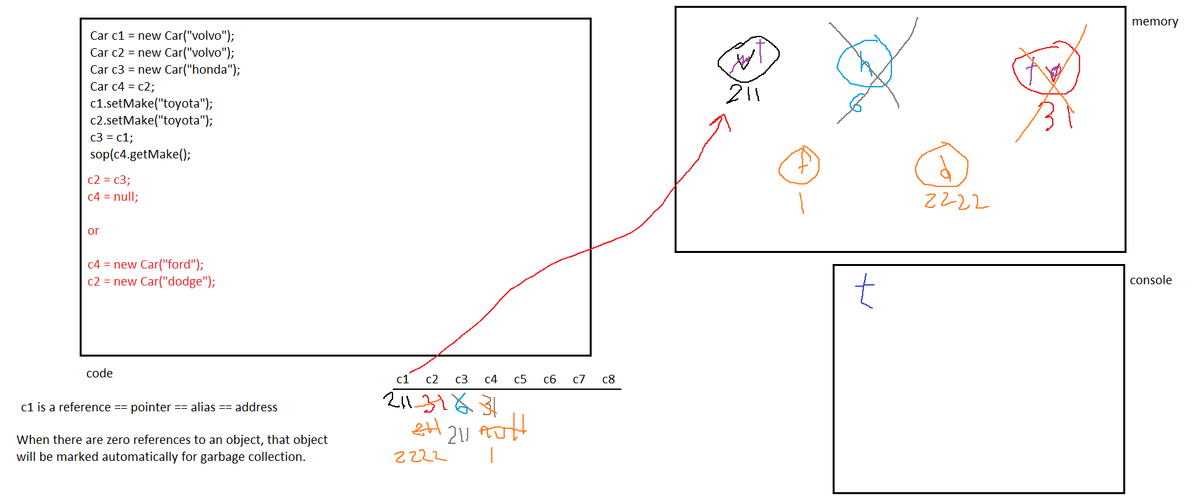
References vs. Objects

Slide 4
Homework etc
Every team will make very simple notes about their Design Pattern (1-3 slides)
Every team will also make a very simple Java project (1/2 page to 1 page)
Every team will also make a very simple lab about their Design Pattern
Every team will also make a sample solution for their lab
Every team will also make a very simple quiz about their Design Pattern
Every team will also make a sample solution for their quiz
Counts as a lab and will be used for exam questions
Copy Jason’s style if you want

Slide 5
Design Pattern #1 of 5: Singleton
Sometimes multiple objects of a class are neither needed nor wanted
Examples: expensive remote database connections; log files
We don’t want hundreds of connections to a log file; just create one and other requests will piggyback on that single connection
This saves resources and time
Problem: whenever a constructor is called an object reference is returned and a new object gets created in memory
Solution: make the constructor private (therefore uncallable outside the class)
New Problem: now ZERO objects can be constructed outside of that class
Second Solution: make a static method which acts like a “substitute constructor” but which creates a new object (by calling the private constructor) if and only if there is no existing object; otherwise it simply returns a reference to the already-existing object.

Slide 6
Singleton in Action
public class DbConnection
{
private static DbConnection d;
static
{
d = null; // singletons have 0 or 1 objects only
}
private DbConnection(final String host, final String user, final String pass)
{
// do normal constructor stuff here
}
public static DbConnection getInstance(final String host, final String user, final String pass)
{
if(d == null)
{
d = new DbConnection(host, user, pass); // there was no object, so make one
}
return d; // return the existing object
}
}

Slide 7
Singleton Lab and Quiz
Lab:
Use a Singleton Design Pattern to create a class called LogFile
No matter how many requests are made to create LogFile objects, only a single instance (maximum) will ever exist
Quiz:
Why would we use a Singleton design pattern? Give a real-life example. Log file, expensive database connections.
What are the important ingredients to implement a singleton? Private constructor, non-private static substitute constructor which returns a reference to a static variable. This substitute constructor will call the private constructor if no object yet exists.

